Slide 1



Research Paper Summary
Course Code : CSE418
Course Title : Scientific Research and methodologies
12 November, 2024
Submitted By -
Md. Mehadi Hasan, ID - 2125051003
Maheru Tabassum Ohana, ID - 2125051015
Mofidul Haque Nibir, ID - 2125051020
Sowrobh Bhuiyan, ID - 2125051026
Submitted To -
Ratri Datta
Lecturer, Department of CSE
University of Information Technology and Sciences
1

Slide 2

Title : Automatic number plate recognition using deep learning
The paper develops an ANPR system using deep learning to detect and read license plates in real-time, aiming to enhance traffic monitoring and security. It uses YOLO for vehicle detection and OCR for character recognition, achieving high accuracy for practical applications.
2

Slide 3


Model’s Used :
Dataset and Training:
Two CNN-based models:
Two datasets are used:
01
YOLO Model: Used to detect vehicles in video frames captured by roadside cameras.
01
Vehicle Dataset: Stanford Cars dataset for vehicle detection.
02
OCR (Optical Character Recognition): Extracts and recognizes characters from the detected license plates.
02
License Plate Dataset: Custom dataset with Tamil Nadu license plates.
3

Slide 4

Literature Review :
Traditional ANPR: Used template matching; limited by low accuracy in varied conditions.
Machine Learning: Edge detection, ANNs; improved but limited.
Deep Learning: CNNs boosted accuracy.
YOLO + OCR: Real-time detection; high efficiency.
Challenges: Plate variety, lighting, real-time in dense traffic.
4

Slide 5


Methodology
Data Preparation: Collect vehicle and license plate images; annotate with LabelImg."
Vehicle Detection: YOLO model detects vehicles in frames."
License Plate Localization: Identifies and extracts license plates from detected vehicles."
Character Recognition: OCR model reads characters on plates, saving them to a database."
5

Slide 6

System Workflow:
Video Processing: Video footage from CCTV is split into individual frames.
Vehicle Detection: The YOLO model detects vehicles in frames.
License Plate Detection: Detected vehicles are further processed to locate license plates.
Character Recognition: OCR extracts text from detected license plates, storing data like time, date, and license number in an Excel sheet.
6

Slide 7


Performance, Limitations & Challenges :
Performance | Limitations | Challenges
Achieved accuracies: Vehicle Detection: 97% License Plate Localization: 98% Character Recognition: 90% | YOLO's limitations in real-time processing, especially in high-density traffic. | Variability in license plate standards across regions and different lighting conditions.
7

Slide 8

Result and Conclusion :
The system achieved high accuracy in detecting and recognizing number plates, suitable for real-time applications.
The ImageAI library proved effective in reducing code complexity and increasing performance.
8

Slide 9
Title : Intelligent Car Detection and License Plate Recognition System
The paper presents a system that leverages car detection and license plate recognition technology to automate vehicle identification, responding to the rapid growth of transportation systems. This technology is especially beneficial in traffic-heavy environments such as universities, malls, and toll booths, where manual monitoring is challenging and inefficient. By extracting and storing license plate details in a central database, the system supports efficient traffic monitoring, security enhancement, and regulatory enforcement.
9

Slide 10
Model’s Used :
Dataset and Training:
Two CNN-based models:
Two datasets are used:
01
Artificial Neural Networks (ANN): classifying and recognizing plate characters even with variations in font and style.
01
AOLP (Automatic License Plate Recognition) Dataset: Contains images of vehicles with annotated license plates, often used in academic research.
02
OCR (Optical Character Recognition): Extracts and recognizes characters from the detected license plates.
02
Customized Local Datasets: Institutions may compile their own images to account for regional variations in license plate format and font.
10

Slide 11
Literature Review :
Color Edge Detection and Fuzzy Maps
License Plate Segmentation and Processing
Artificial Neural Network (ANN)-Based Recognition
Edge Detection and Window Filtering Techniques
11

Slide 12
Methodology
License Plate Localization: Detecting the plate's position in the image, regardless of orientation.
Character Segmentation: Extracting each character from the plate.
Character Recognition: Applying OCR techniques to identify each character, converting it into machine-readable data.
12

Slide 13
Results and Performance :
The implemented model demonstrated successful detection and recognition of license plates under varying angles and lighting conditions.
The system’s accuracy can be affected by factors like font style and lighting, but it achieves reasonable reliability with an average accuracy rate of 80.8%.
13

Slide 14
Future Scope :
Improved camera positioning for optimal frame capture.
Use of convolutional neural networks for refined detection and recognition.
Multi-vehicle detection within a single frame through genetic algorithms.
14

Slide 15
Conclusion :
The intelligent car detection and license plate recognition system offers a practical solution for automated vehicle identification.
With the ability to function across diverse environmental conditions, the system is suitable for parking management, toll booths, and security applications.
The integration of neural networks and template matching techniques further enhances its robustness.
15

Slide 16
Title : TRAFFIC RULES VIOLATION DETECTION SYSTEM
This paper presents a system that uses computer vision to detect traffic violations, specifically focusing on red-light violations. The system uses video footage to detect vehicles crossing a designated line when the traffic signal is red. The key components are vehicle detection using YOLOv3 and an easy-to-use graphical user interface (GUI).
16

Slide 17
Technologies Used:
Dataset and Training:
Three datasets are used:
01
OpenCV: Used for processing video feeds and detecting visual inputs.
01
Vehicle Detection: COCO, ImageNet, or KITTI datasets.
02
Traffic Violations: UA-DETRAC or IVVI 2.0 datasets with traffic scenes.
02
GUI with Tkinter: Provides a user-friendly interface to load video footage, mark the violation line, and view detected violations.
03
Synthetic Data: Simulated data from environments like CARLA if real-world violation data is limited.
17

Slide 18
Methodology
Vehicle Detection:
Uses YOLOv3 with Darknet-53 for real-time detection and classification of vehicles in video footage.
Violation Detection:
A virtual line represents the red-light area in the video feed.
If a vehicle crosses this line during a red light, it's marked as a violation, and the vehicle is highlighted with a red bounding box.
GUI (Graphical User Interface):
Built with Tkinter for easy interaction, allowing users to load videos, set violation lines, and view detected violations without code changes.
18

Slide 19
Literature Review :
Traffic Violation Detection: Video-based systems enhance safety by automating violation detection (Wang et al., 2013).
YOLOv3 for Object Detection: YOLOv3 enables fast, accurate vehicle detection (Redmon & Farhadi, 2018).
Privacy in Enforcement: Automated systems can secure privacy (Ozkul & Capuni, 2018).
19

Slide 20
System Design:
Composed of two primary elements:
Vehicle Detection Model: Identifies vehicles in real-time from video input.
Graphical User Interface: Enables users to interact with the system without needing to alter code.
20

Slide 21
Future Work:
Enhance system performance by optimizing runtime.
Expand detection capabilities to other types of traffic violations and integrate license plate recognition.
21

Slide 22
Result :
The system is more efficient than manual observation by traffic police and can process a single data stream at a time.
Limitations:
Slower runtime, which could be improved with a more powerful system.
Currently detects only red-light violations; future improvements aim to detect additional violations (e.g., speeding) and recognize vehicle license plates.
22

Slide 23
Title : Optical System to Recognize Car Plate Ownership
• Topic: Overview of optical systems for car plate recognition.
• Purpose: To enhance vehicle identification for security and monitoring.
• Importance: Practical implications for law enforcement, parking, and toll management.
23

Slide 24

Literature Review
Reviews previous studies on optical character recognition, license plate detection
Comparison of different methods (e.g., OCR, image processing).
Identified gaps and needs for improvement.
24

Slide 25
Methodology
Approach: Optical character recognition (OCR) combined with image preprocessing.
Data Collection: Image dataset of vehicle plates under varied conditions.
Techniques Used: Noise reduction, edge detection, and character segmentation.
Algorithom : Cascade classified based Viola Jones Algorithom
25

Slide 26

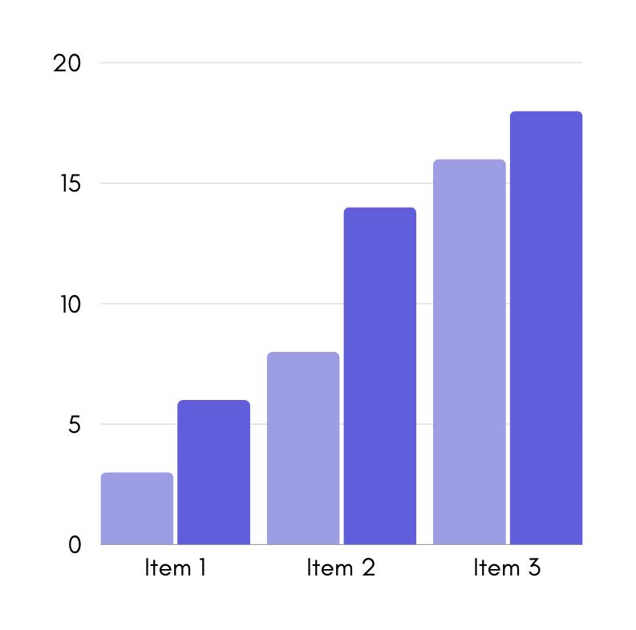
Results & Limitations
The accuracy of Detection 100% and an accuracy of character recognition 99.8% using cascade classifier based viola jones algorithom
The optical system must be at 1 meter or 2-meter height to get optimal results
26

Slide 27
Conclusion :
High accuracy in controlled settings; some limitations in low light.
Improved security, automation in vehicle management.
Enhancing system reliability for real-world application.
27

Slide 28

References :
V Gnanaprakash, "Automatic number plate recognition using deep learning" IOP Conference Series: Materials Science and Engineering, vol. 1084, p. 012027, Aug. 2021. Available: https://iopscience.iop.org/article/10.1088/1757-899X/1084/1/012027/pdf
Abhishek Shah, "Intelligent Car Detection and License Plate Recognition System" International Journal of Research in Engineering, Science and Management (IJRESM), Volume-3, Issue-9, September-2020.Available: https://journal.ijresm.com/index.php/ijresm/article/view/322/297
Noor M Hashem, "Optical System to Recognize Car Plate Ownership" Malaysian Journal of Fundamental and Applied Sciences (MJFAS), vol. 19, 2023 Available: https://mjfas.utm.my/index.php/mjfas/article/view/2991/1767
Mr. M. V. Rajesh, "TRAFFIC RULES VIOLATION DETECTION SYSTEM" International Research Journal of Modernization in Engineering, Technology and Science (IRJMETS), vol. 4, issue. 2, Feb. 2022. Available: https://www.irjmets.com/uploadedfiles/paper/issue_2_february_2022/18784/final/fin_irjmets1643879496.pdf
28

Slide 29

29

Slide 30

Any Question ?
30

